Slide 1


King County Housing Analysis
By: Namita, Jose, and Jeremias

Slide 2

Agenda
Business Understanding
Data Understanding
Our Research
Research Results
Conclusion

Slide 3

Business Understanding
Our team was hired to explore King County in Washington & what factors contribute to the price.
What we see?
~ 24,000 homes on the market
Median home price of $450,000
Mean home price of ~ $360,000
What we want to see?
The most important features that correlate to home price.

Slide 4
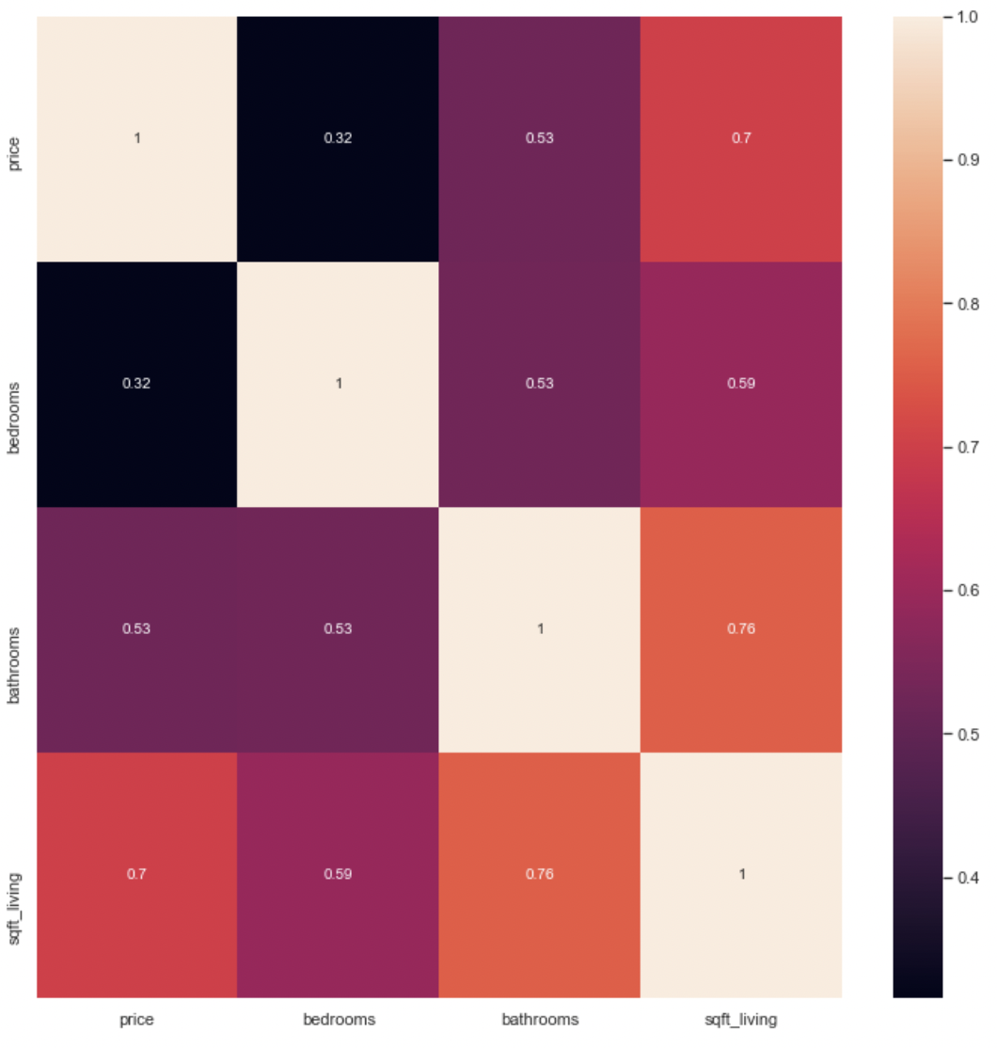
Real Estate Features That Influence Price:
Price
Bedrooms
Bathrooms
Square foot living
Square ft lot
Floors
Waterfront
View
Grade

Slide 5
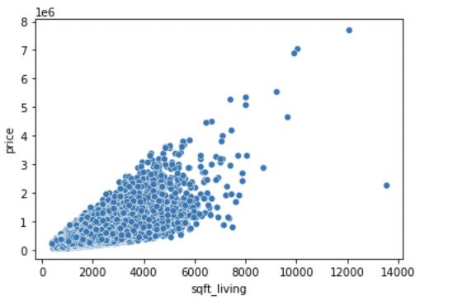
What Our Data Can Answer?
How house prices related to square foot living?
Does number of bedrooms & bathrooms affect the price?
How does factors such as grade, condition, and view affect price?
Do people care about the year a house was built in? Does it affects the cost?

Slide 6
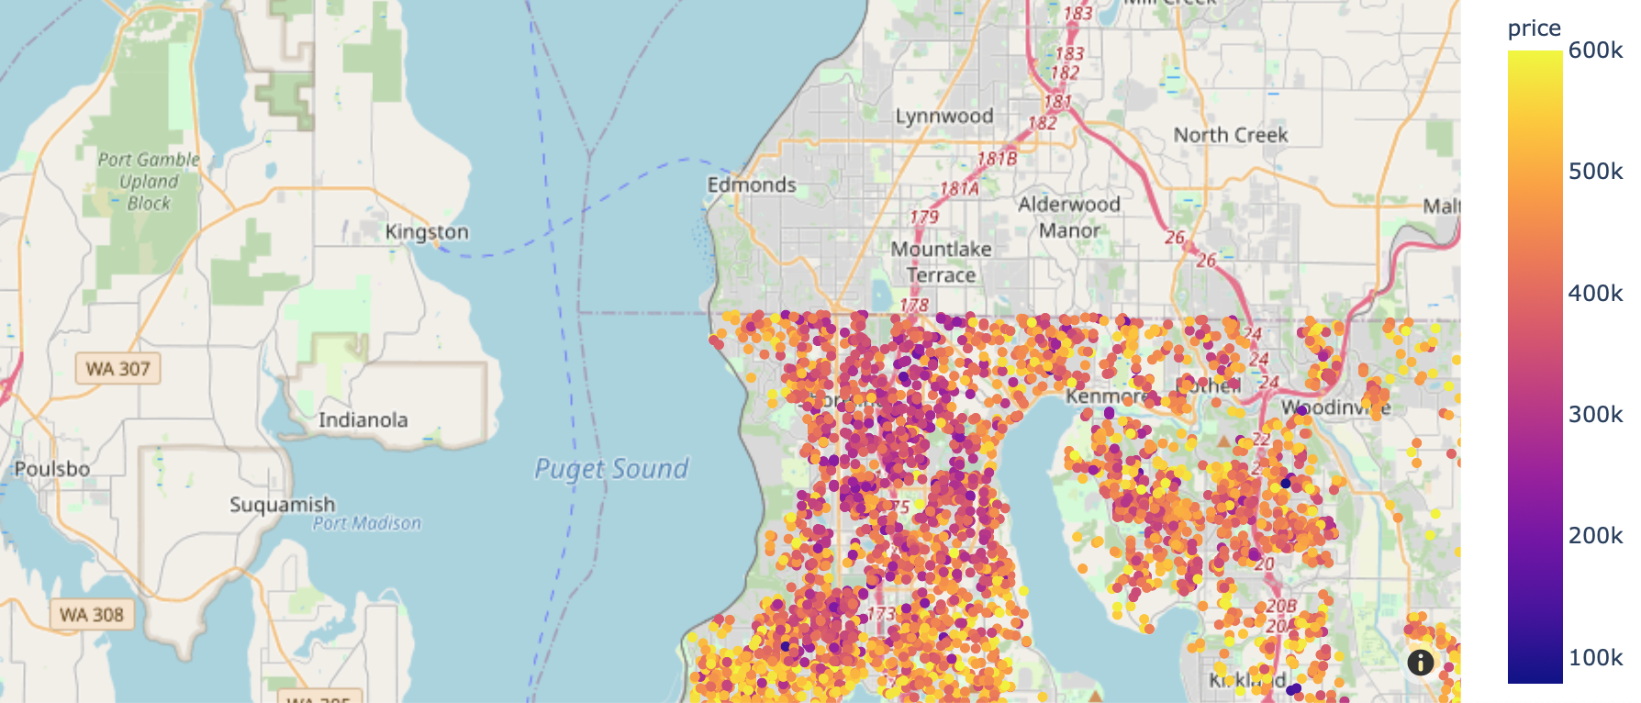
Houses with Median prices:

Slide 7
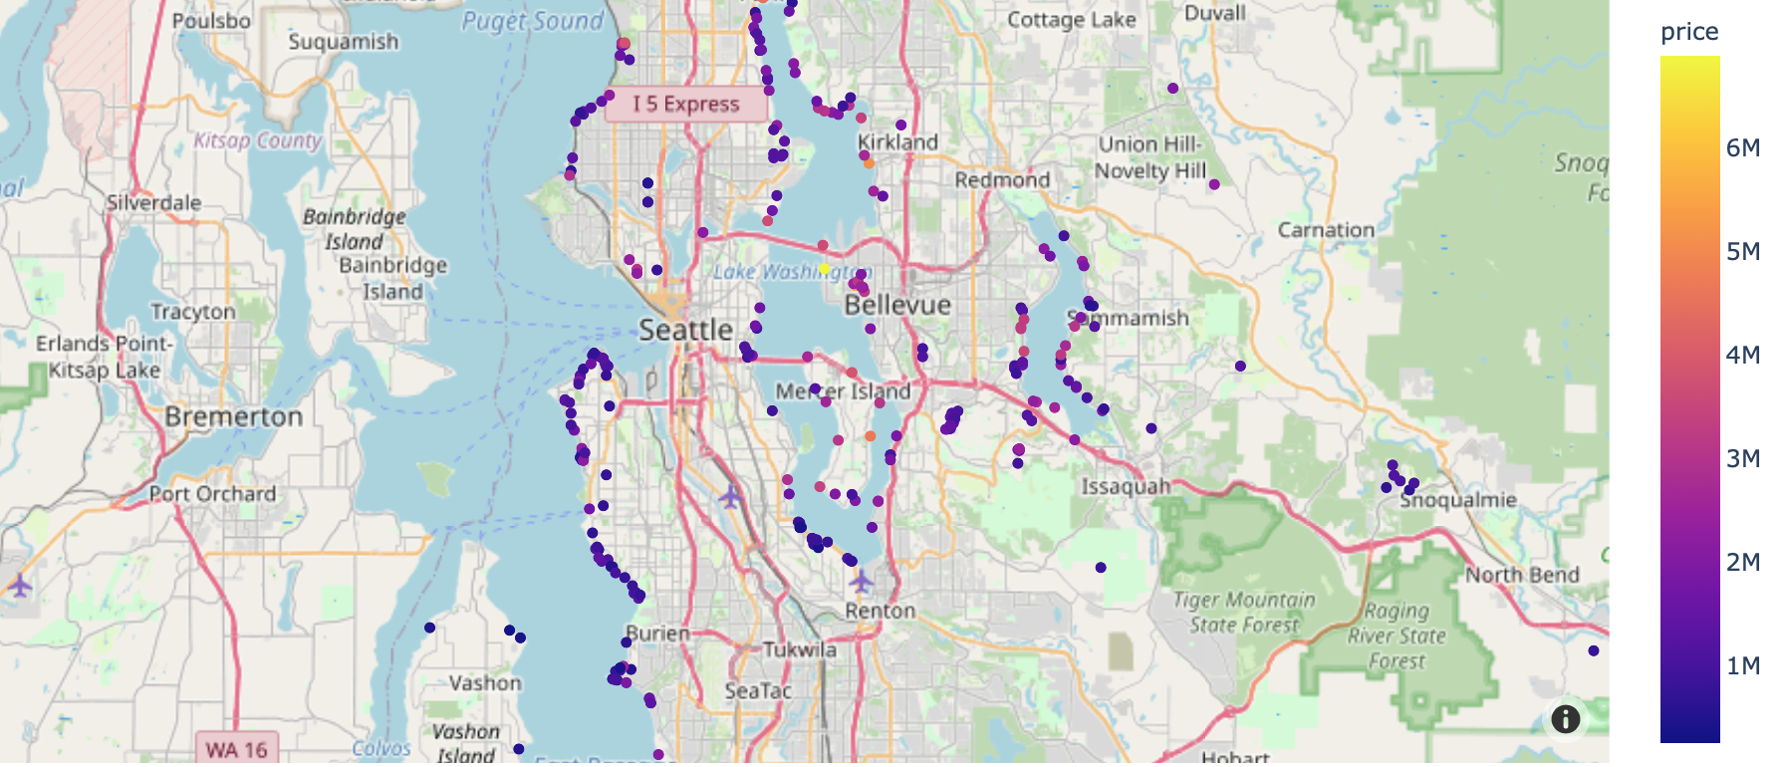
Houses with Excellent views.

Slide 8
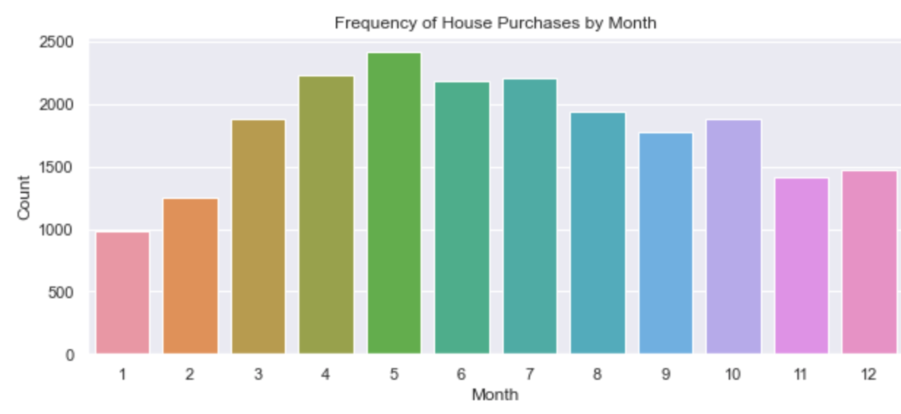
House Purchases by Month.

Slide 9

Modeling:
Predictive model:
Model:
Factors like influence of sqft_living, bedrooms, and/or bathrooms on price are evaluated.
This second model is be built on top of Model 1
Explained variance: 61%

Slide 10

Regression Results
Our regression results show significant improvement on our metrics.
Model 1 concluded that sqft living is the most correlated factor when it comes to price.
Model 2 performed better than Model 1.
Model 1:
R2: 0.54
RMSE:248717.1
Model 2:
R2: 0.61
RMSE: 22716.2

Slide 11

Our model concludes bathrooms & bedrooms are collinear which contribute to higher sale prices.
The higher the grade of a house, the higher the price.
Features like waterfront & view contribute to a higher price.

Slide 12


